Slide 1
INFO-332 Course Overview Spring 21-22
Milad Toutounchian, PhD
Assistant Teaching Professor
Drexel University

Slide 2
The Data Science Pipeline
Focus of course
Data
Ingest
Wrangle
Explore
Model
Report
80%
20%

Slide 3
Data Wrangling
Raw data rarely comes in the ‘perfect’ format for consumption by the Data Scientist
Wrangling involves cleaning, transforming, joining, reshaping, summarizing, aggregating (etc.) data
Wrangling is the most foundational Data Science/Data Engineering skill
The core concepts of data wrangling are the same across programming languages

Slide 4
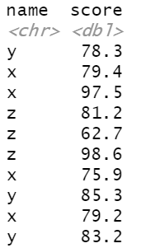
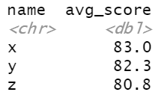
Data Wrangling Example: Aggregation
Input
Output
?

Slide 5




Data Wrangling Example: Aggregation
Input
grades_df %>% group_by(name) %>% summarize(avg_score = mean(score))
Output
SELECT name, avg(score) as avg_score FROM grades_df GROUP BY name
grades_df.groupBy(“name”)
.agg(avg($“score”).as(“avg_score”))
grades_df.groupBy([‘name’])
.agg({‘score':{‘avg_score’: ‘mean’,}})

Slide 6
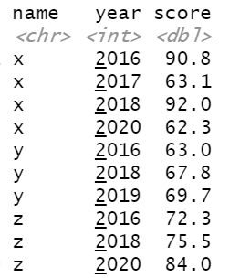
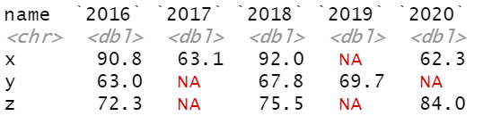
Data Wrangling Example: Reshaping
Input
Output
?

Slide 7
Data Exploration
Uncovering hidden relationships in data; often in support of a hypothesis
Focuses on developing deep understanding of the data in relation to the problem/question at hand
Involves heavy use of visualization techniques to share findings with audience/stakeholders
May involve basic use of statistics

Slide 8
Data Visualization
Types of variables involved in analysis (numeric, categorical, date/time, etc.)
Appropriate plots for visualizing relationships between variables of different type (scatter plot, line plot, bar plot, box plot, etc.)
Representing multiple dimensions on a single plot (art & science)
Making the plot “tell a story” with little/no explanation needed

Slide 9
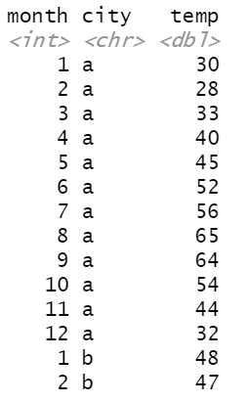
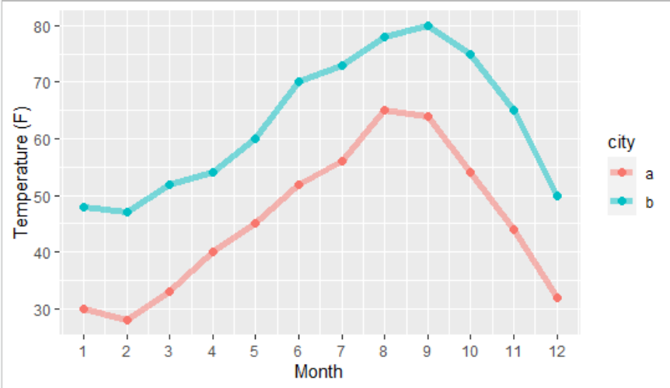
Data Visualization Example
Input
Output
?

Slide 10
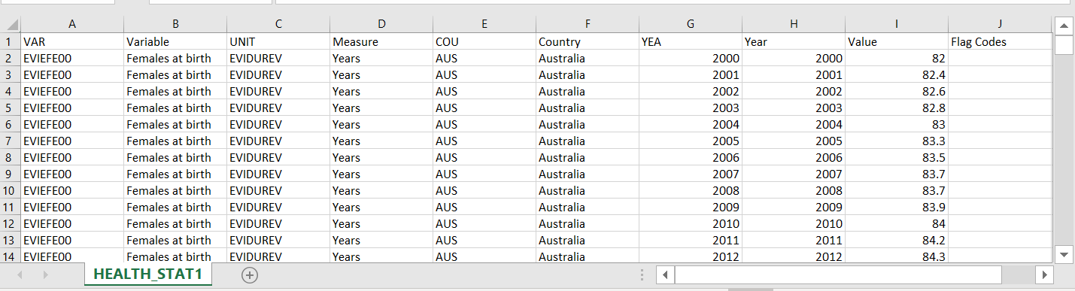
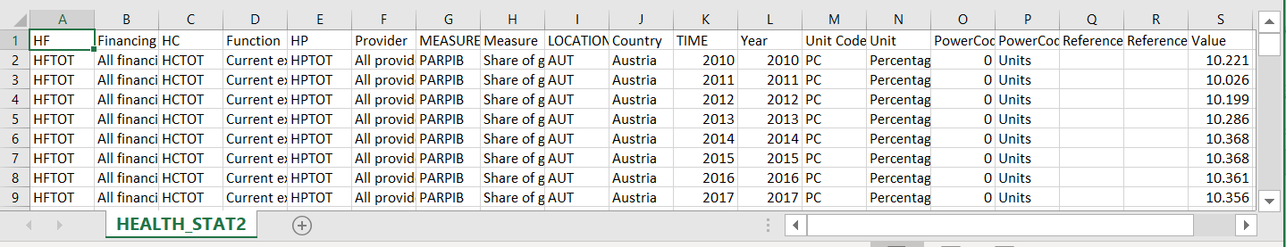
Example: Raw Data

Slide 11
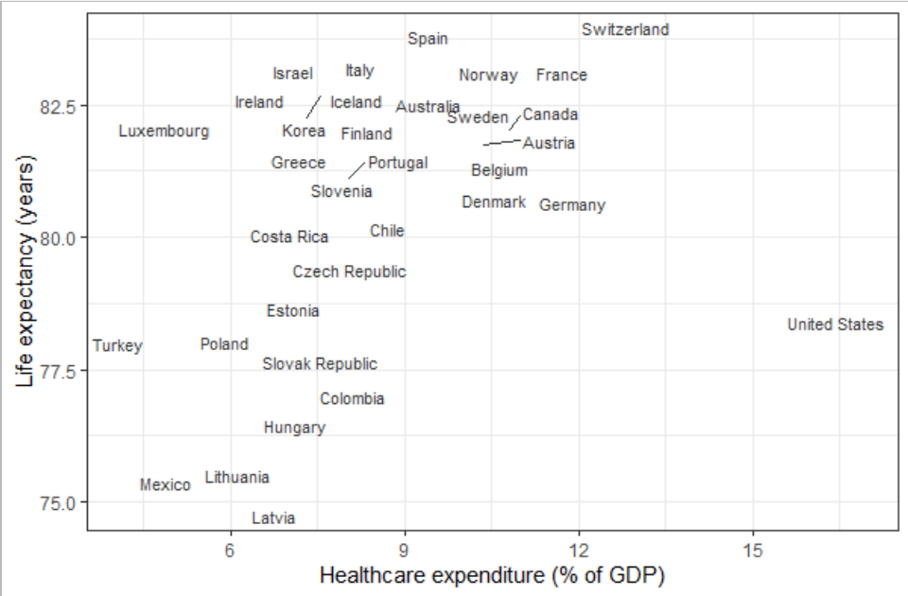
Visualization as a Mean to Tell Story

Slide 12
Course Core Principles
I cannot teach you how to code, but I can facilitate the learning process
How much you learn depends on the effort you put in
Lectures are designed to run as a “lab”
Engagement correlates with performance

Slide 13
Course Components
Lectures (lessons available in HTML format on BB Learn)
datacamp Modules
Weekly Quizzes (meant as comprehension checks)
Assignments (3 in total)
Exams (Midterm and Final)

Slide 14
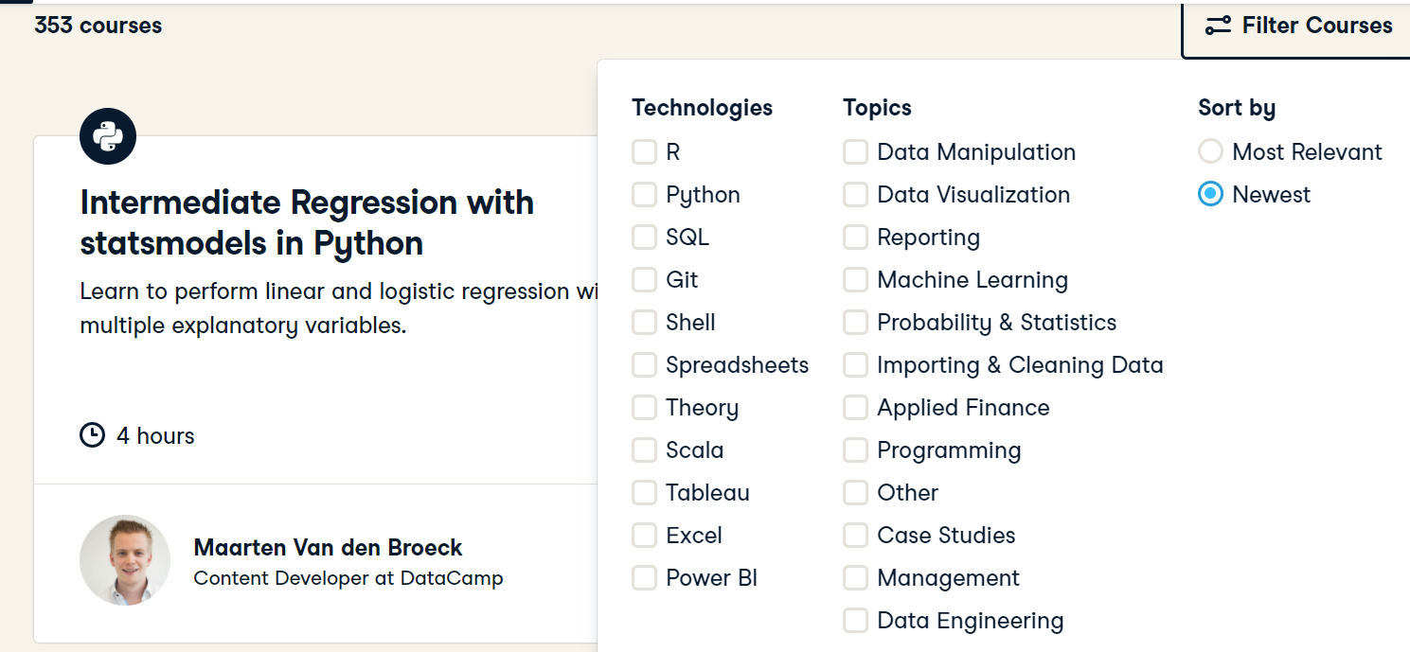
Access to the Full datacamp Catalog!

Slide 15
Questions?

